Slide 1
Chapter 26
Sources of Magnetic Field
Biot-Savart’s Law
Magnetic Flux and Gauss’ Law
Ampere’s Law

Slide 2
New Words and Expressions
Biot-Savart’s Law 毕奥—萨伐尔定律
solenoid 螺线管
toroid 螺绕环
Ampere’s Loop Law 安培环路定理

Slide 3






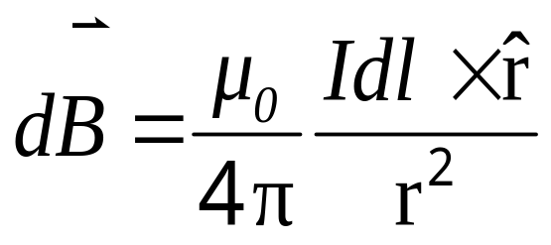



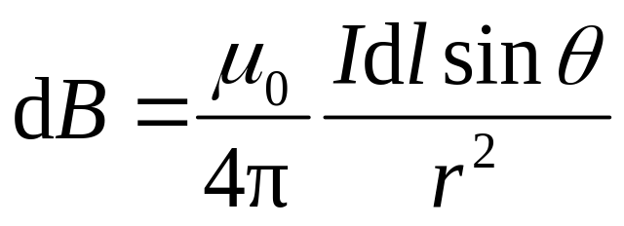
26-6 Biot-Savart’s Law (P613-616)
1. Biot-Savart’s Law毕奥—萨伐尔定律:
(电流元在空间产生的磁场）
The current element Idl generates a magnetic field dB given by:
P
*

Slide 4
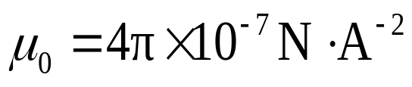
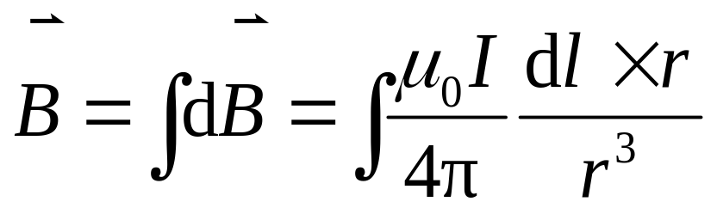
真空磁导率
Magnetic permeability constant in a vacuum.
The principle of superposition of magnetic field, can be applied for a complete circuit:
任意载流导线在点 P 处的磁感强度

Slide 5

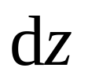





2. The Application of Biot-Savart Law:
1) A Long Straight Wire (载流长直导线的磁场P614):
For the field near a long straight wire carrying a current I, Determine the magnetic field.
D
Solution:
*
P
方向均沿 x 轴的负方向
C

Slide 6
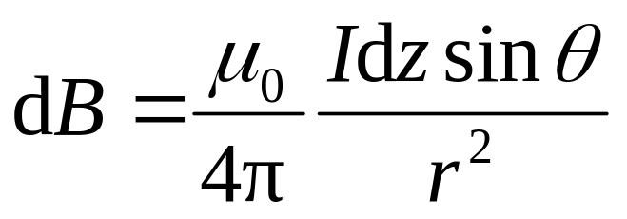

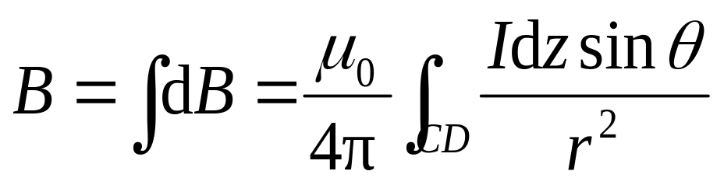

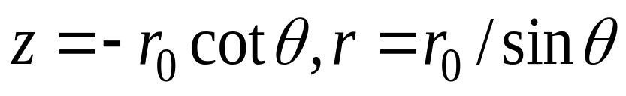
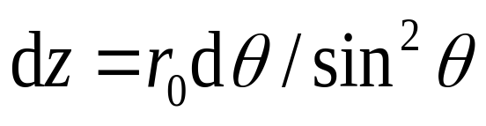

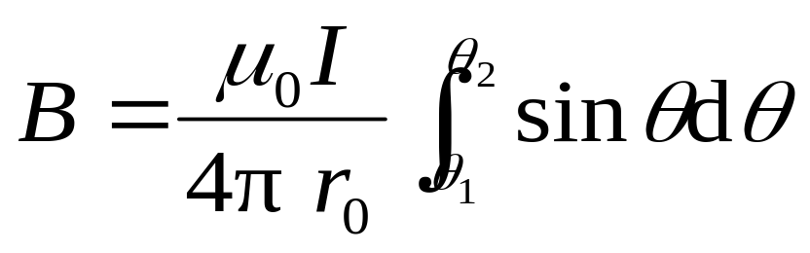
The magnitude of the differential magnetic field produced at P by the current-length element Idz located a distance r₀ from P is given by:
D
*
P
C

Slide 7

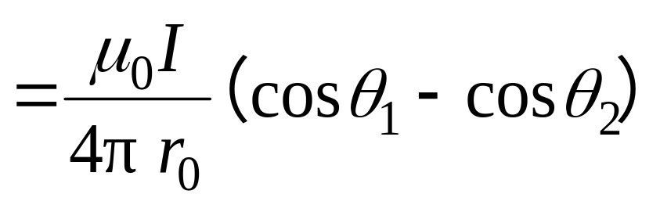


Discussions:
(1) The magnetic field from all current element of straight wire are in the same direction and into the screen.
D
+
P
的方向沿 x 轴的负方向.
C

Slide 8
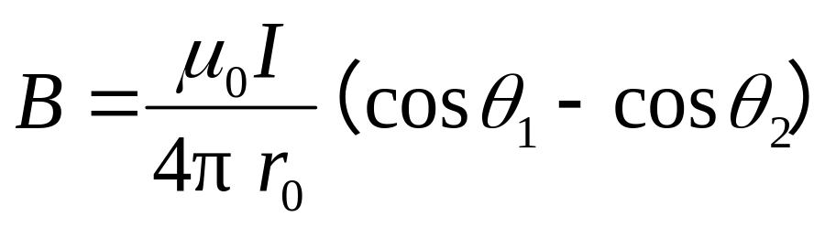
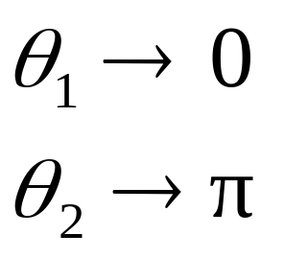
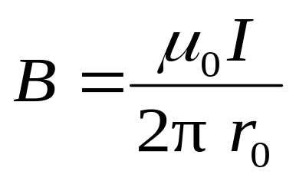


(2) For straight and infinite wire (无限长载流直导线), θ₁=0,θ₂=π,then
I
The magnitude of magnetic field of infinite straight wire at a point is inversely proportional to the distance r₀.
I

Slide 9
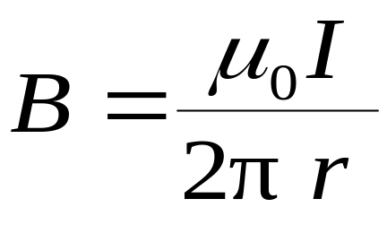
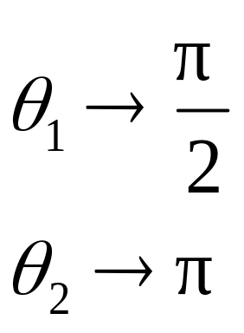
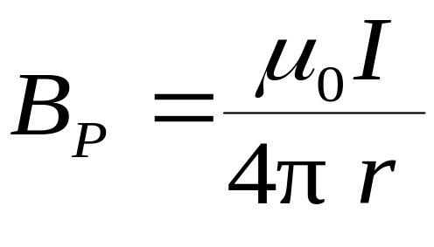


无限长载流长直导线的磁场
I
I
B
X
B
电流与磁感强度成右螺旋关系
半无限长载流长直导线的磁场
P
*

Slide 10


2) Current Loop p615
Determine for point on the axis of a circular loop of wire of radius R carrying a current I.
真空中 , 半径为R 的载流导线 , 通有电流I , 称圆电流. 求其轴线上一点 p 的磁感强度的方向和大小.
p
*
I

Slide 11
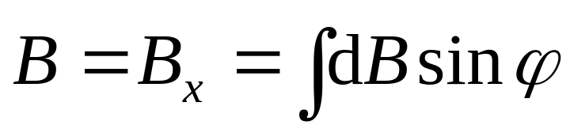



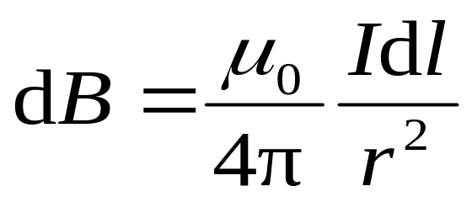
解 根据对称性分析
p
*
I

Slide 12
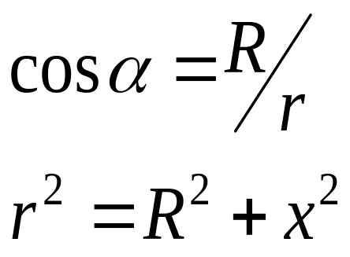

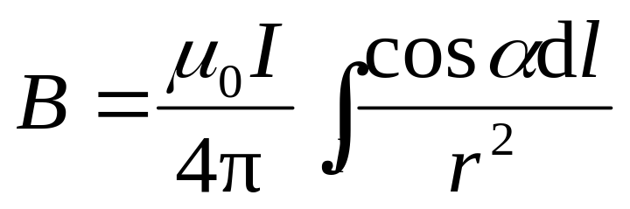
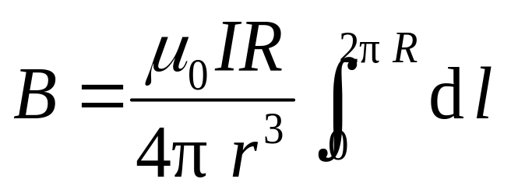

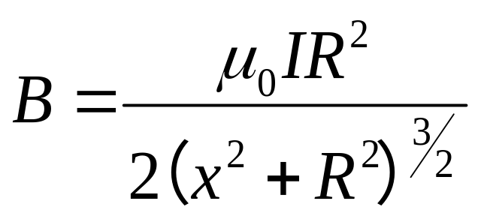
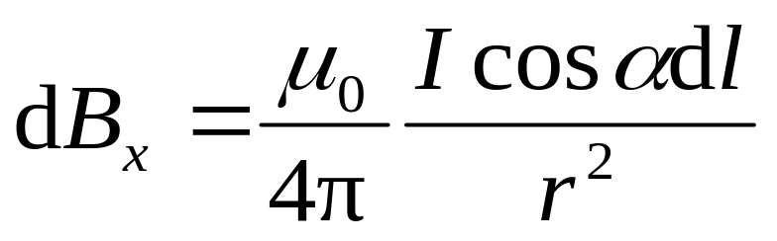
*
p

Slide 13
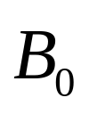



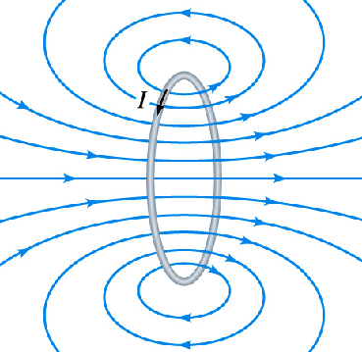

Discussions:
(1) At center O
R
x
I
o
(2) The direction of is along the axis direction (right-hand rule) as right figure.

Slide 14
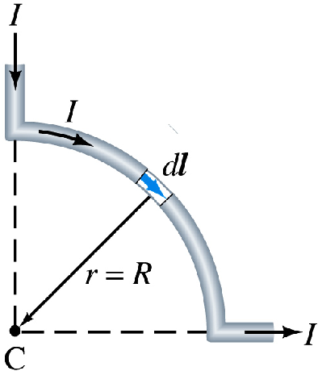

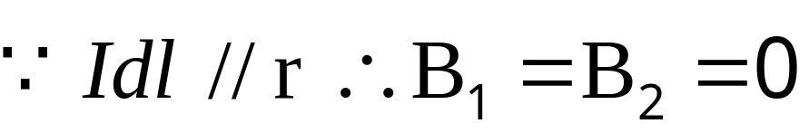
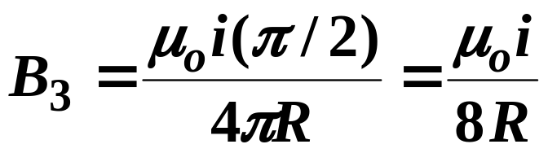
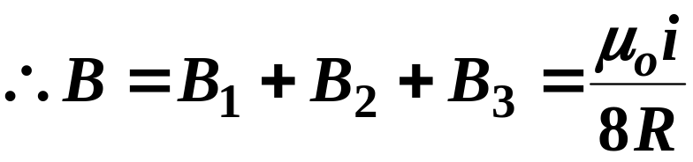
EXAMPLE 26-11 of P616:
One quarter of a circular loop of wire carries a current I, and two straight sections whose extensions intersect the center C of the arc. Find at point C?
1
3
2
Solution:
For parts 1 and 2,
(direct into the screen)
(into the screen)

Slide 15
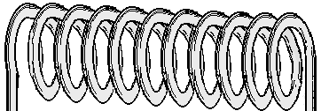
3) A Stretched-out Solenoid (载流直螺线管轴线上的磁场)
如图所示，有一长为l , 半径为R的载流密绕直螺线管，螺线管的总匝数为N，通有电流I. 设把螺线管放在真空中，求管内轴线上一点处的磁感强度.
I
I

Slide 16
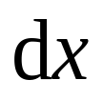
The number of turns per unit length of the solenoid(单位长匝数) n. As vertical cross section (纵剖面) shown, (I, n, R, L, β_{1,} β₂ )
R
o
*
p
+
+
+
+
+
+
+
+
+
+
+
+
+
+

Slide 17
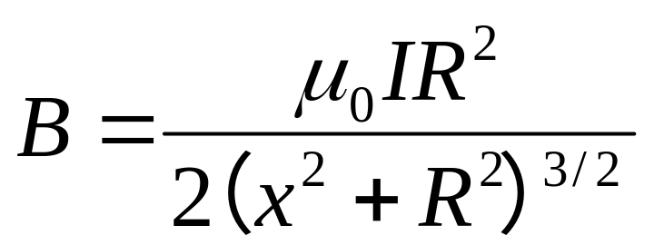



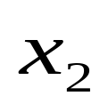
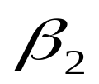
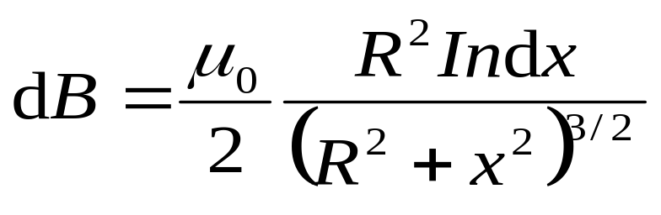
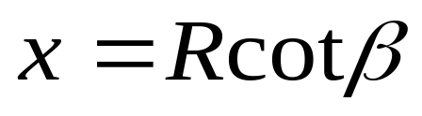
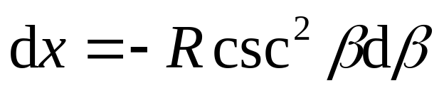
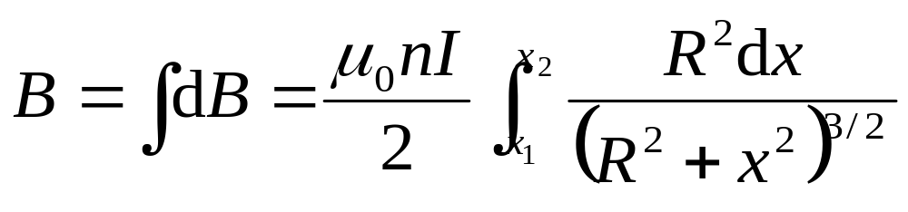
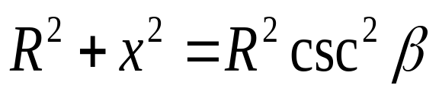
解 由圆形电流磁场公式
o
p
+
+
+
+
+
+
+
+
+
+
+
+
+
+
+

Slide 18
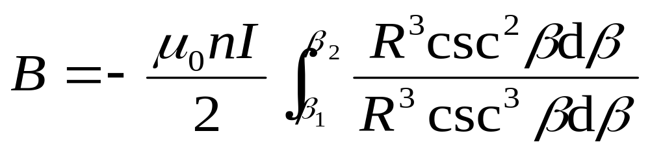
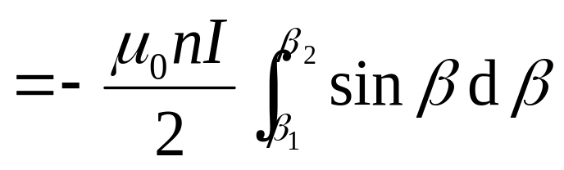
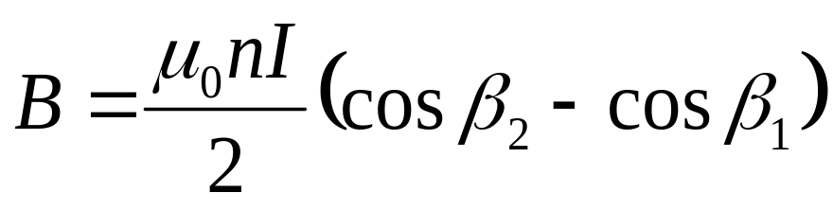

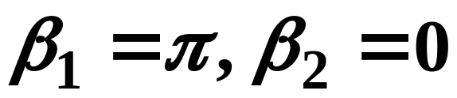
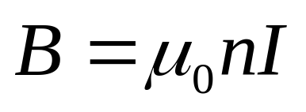
For a “infinitely long” solenoid, The at the axial line:

Slide 19
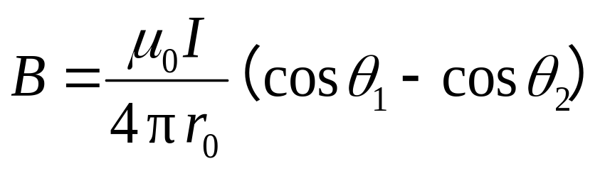
Summary of the Application of Biot-Savart Law:
A Long Straight Wire
A Circular Arc of Wire
A Stretched-out Solenoid

Slide 20
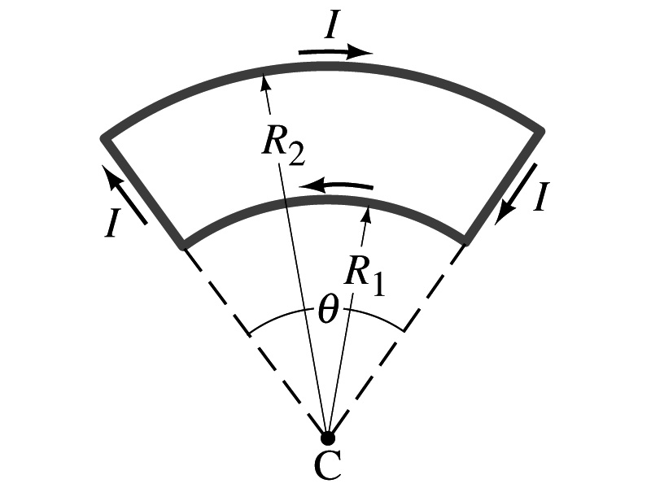
P624:30 A wire in a plane has the shape as shown in Fig. Two arcs of a circle connected by radial lengths of wire. Determine magnetic field at point C.

Slide 21
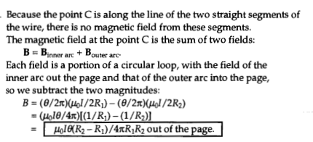
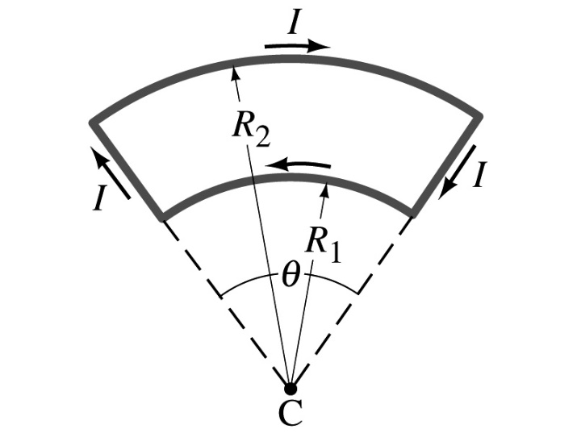

Slide 22
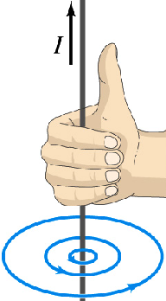
25-2. Magnetic Field lines and Flux (P581)
1. The features of magnetic field lines:
♣ No origin, no termination and no cross point(无头无尾不相交,闭合曲线);
♣ Wrap around with current与电流套连;
♣ Right-hand rule with current (与电流成右手螺旋关系)
规定：曲线上每一点的切线方向就是该点的磁感强度 B 的方向，曲线的疏密程度表示该点的磁感强度 B 的大小.

Slide 23















2. Magnetic flux & Gauss’ law:
单位

Slide 24











磁场高斯定理
(Gauss’ law of magnetic field)
The magnetic flux threading a closed surface is zero.
物理意义：通过任意闭合曲面的磁通量必等于零
（故磁场是无源的.）

Slide 25













例 如图载流长直导线的电流为 , 试求通过矩形面积的磁通量.
解 先求 ，对变磁场给出 后积分求 .

Slide 26




26-4&26-5. Ampere’s Loop Law p607-613
1. Ampere’s Loop Law 安培环路定理 (P607-611):
Any line integral of around a closed path is proportional to the current encircled by the path.
即在真空的稳恒磁场中，磁感应强度 沿任一闭合路径的积分的值，等于 乘以该闭合路径所包围的各电流的代数和.

Slide 27





Explanation:
Contributed by all current in space.
Freely choose a closed loop and assign a positive direction.
Any differential elements on the L, along the tangent direction to the loop.
The net current encircled by the loop (与L套连的电流,回路所围面积截得)accord with right-hand rule
电流 正负的规定 ： 与 成右螺旋时， 为正；反之为负.

Slide 28








问 1） 是否与回路 外电流有关？
2）若 ，是否回路 上各处 ？
是否回路 内无电流穿过？

Slide 29

2. The Application of Ampere’s Law
It plays very important role in the theory of magnetic field. One can also use Ampere’s law to calculate with symmetrical distribution of current.
Main Steps: P611
1) Symmetry analyses (由I的分布分析分布的对称性);
2) Choose a loop (使回路上各处B相等，方向特殊，从而可从回路积分中提出B)；
3) Put into the law and calculate B.

Slide 30




Example: Find the inside and outside a long straight wire of radius R and uniformly distributed current I over a cross section of the wire (无限长载流圆柱体的磁场).
Solution:
1) Cylindrical symmetry:
The magnetic field must be the same at all points that are the same distance from the center of the conductor.
.

Slide 31








2） Choose a circular loop (选取回路)
的方向与 成右螺旋

Slide 32





The field is zero at the center of the conductor and increases linearly with r until r=R; beyond r=R, B decreases as 1/r.

Slide 33








例 无限长载流圆柱面的磁场
解

Slide 34
Read and discuss the example 26-5 and 26-6 on page 610 (Conceptual examples)
Coaxial cable and a nice use for Ampere’s Law

Slide 35
求长直密绕螺线管内磁场 P611
Find inside and outside a “infinitely long” solenoid (The number of turns per unit length of the solenoid n and total number of coils N).
Solution:
For a “infinitely long” solenoid, The at the axial line:

Slide 36







Based on the feature of the distribution of , we choose a rectangular loop MNOP. MN is on the axial line:
M
N
P
O
+
+
+
+
+
+
+
+
+
+
+
+

Slide 37



Based on the feature of the distribution of , we choose a rectangular loop MNOP. MN is on the axial line:
M
N
+
+
+
+
+
+
+
+
+
+
+
+
P
O

Slide 38



Example: Toroid. Determine the magnetic field: a) inside a toroid and b) outside a toroid.
Solution:
From symmetry, the lines of form concentric circles with the toroid, directed as figure.
R₂
R₁

Slide 39








Choose concentric (同心) circle loop L, (R₁ < r < R₂ ),
(Right-hand rule direction)
令
当 时，螺绕环内可视为均匀场 .

Slide 40



Choose concentric circle loop L, (r > R₁ or r< R₂),

Slide 41


Discussion:
1) The magnetic field is not uniform within the toroid, it is largest along the inner edge and smallest at the outer edge.
2) In contrast to the situation for a solenoid, B is not constant over cross section of a toroid. But if its cross area is relatively small, then
It is as same as the expression of the one of long solenoid.
(2) of toroid is limited in its interior.

Slide 42















26-2 Force Between Two Parallel Wires (P605-606)
Two long parallel wires carrying currents exert forces (平行载流导线)on each other as the figure.

Slide 43


Acting force exerted on the 1 or 2 wire in unit-length is same.

Slide 44
Think about how about the force between two antiparallel wire 平行反向载流导线之间的力怎样(方向、大小)?
—— repel each other!
Parallel currents attract, and antiparallel currents repel.

Slide 45

Example 26-3 Suspending a current with a current.
A horizontal wire carries a current I₁=80A. A second parallel wire 20cm below it must carry how much current I₂ so that it doesn’t fall due to gravity? The lower wire has a mass of 0.12g per meter of length.

Slide 46


Slide 47
Homework 9: p622—628
3, 14, 27, 28, 31, 32, 33, 50, 61

